Slide 1
LIFE INSURANCE MANAGMENT
CHINTHA THANMAI
192011055

Slide 2
Abstract
This Life Insurance Management System is very helpful for any kind of insurance company which in need of managing different type of insurance
To automate the life insurance application which is designed keeping in mind to make it one of the best automation system for keeping all the tracks of the details of their customers
Testing process which include in this automation are :
functionality checking
test scenarios
IT for providing best services to them so that they can generate best revenues for themselves by putting up insurance which is best suited to them.

Slide 3
Objective
To automate life insurance management system-
-using testcases
-based on input and output

Slide 4
Proposed work
Installation of the software to automate the life insurance management-
-android studion-visualization
-visual studio cade-to write code
- Appium- To automate the application
First login to the life insurance website or the application
Sign up with your email or the phone number
Create your username and password
Then search for options
Enter the code
Then search for your available jobs

Slide 5
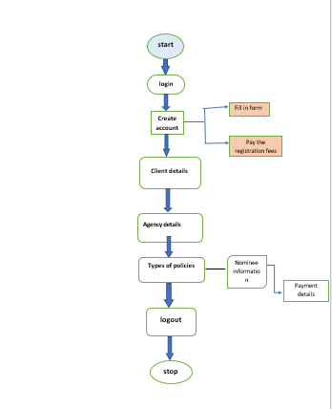
Flow chart

Slide 6
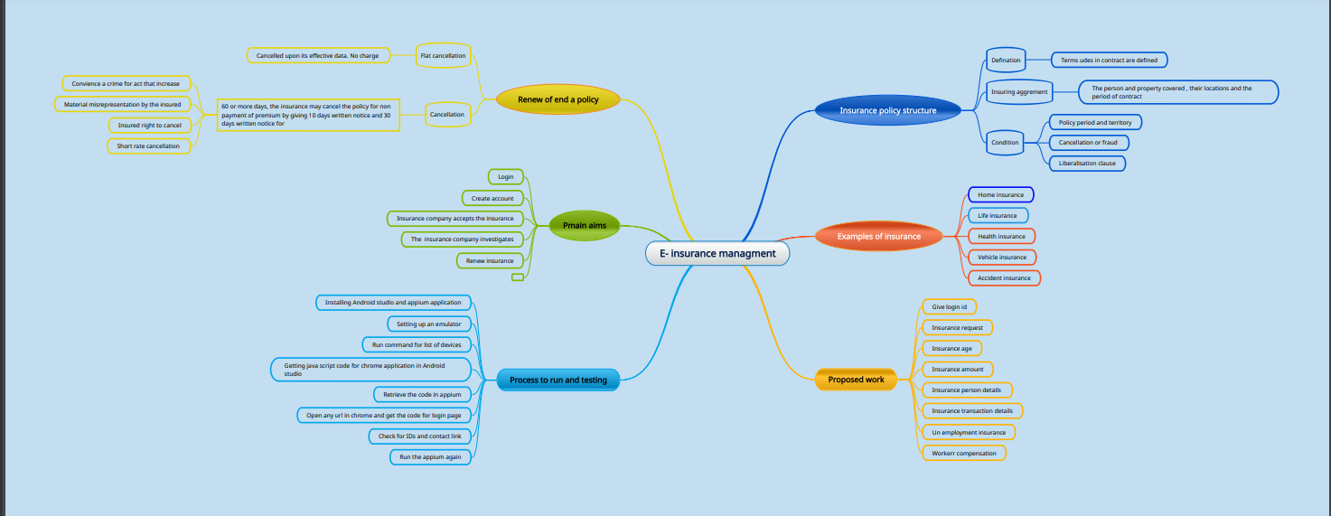
Flow chart

Slide 7
Test cases
Login id
Verify the password
Test the max and min payments
Test scenario for policy termination
Test condition for extended term insurance
Verifying the data
Verifying accounts and reports
Test various conditions for non forfeiture value
Test the agency policy
Test the nominee details

Slide 8
Apps tools and installation
Software
Ram : minimum 2GB
Storage: more than 5 GB
Android studio
Xamp
SQL lite database
WINDOWS LAPTOP
Appium

Slide 9
Hardware
Mouse
Keyboard
Aandroid mobile phones
Input devices
Output devices

Slide 10
Test cases
Test cases | Type – negative/positive
Verify if a user will be able to login with valid username and valid password | Positive
Verify if a user cannot login with valid username and valid password | Negative
Verify the forget password functionality | positive
Verify the scenario of policy termination | positive
Verify the not scenario of policy termination | Negative
Verify the maximum payments | positive
Verify the minimum payments | Negative
Verify if user is able to login with new password only after he/she has changed the password | positive
Verify if user is able to identify the price difference between image and product page | Negative

Slide 11
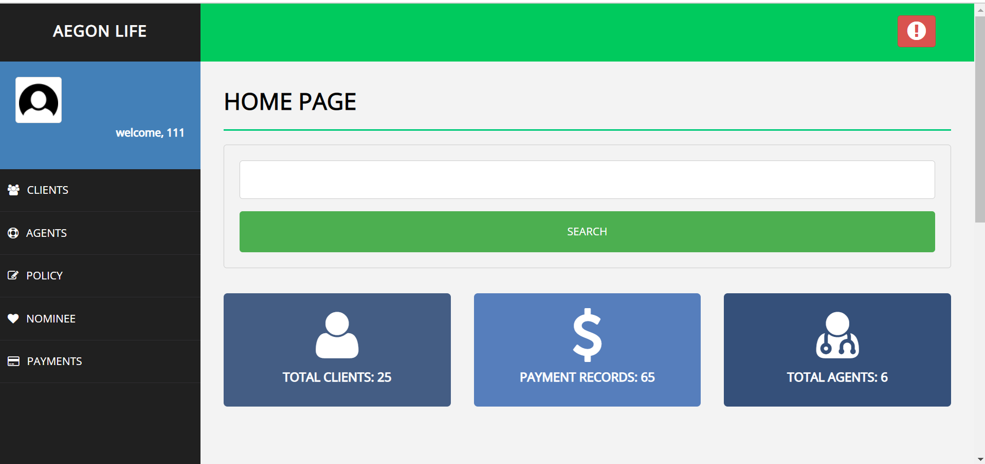
Screen shots

Slide 12
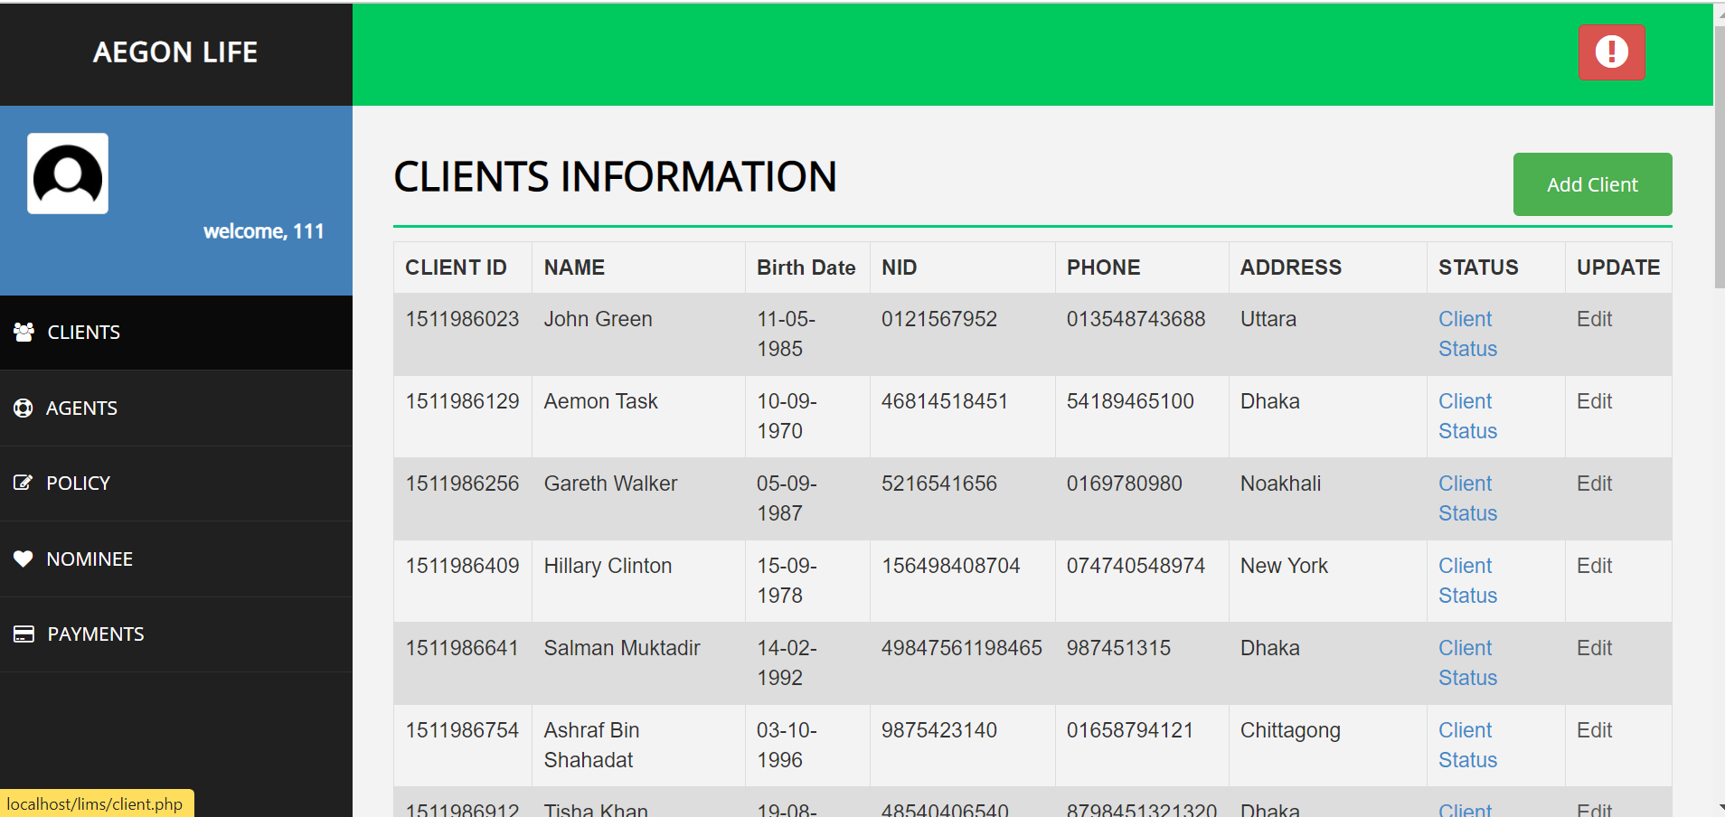
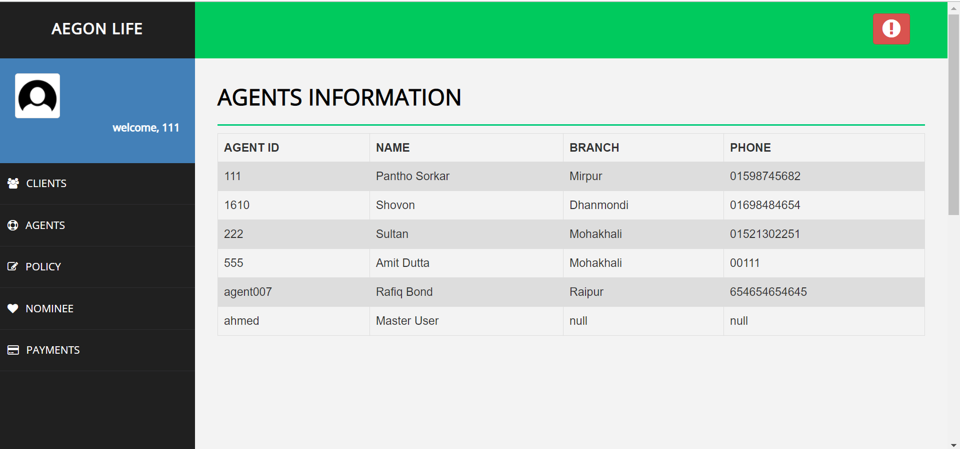

Slide 13
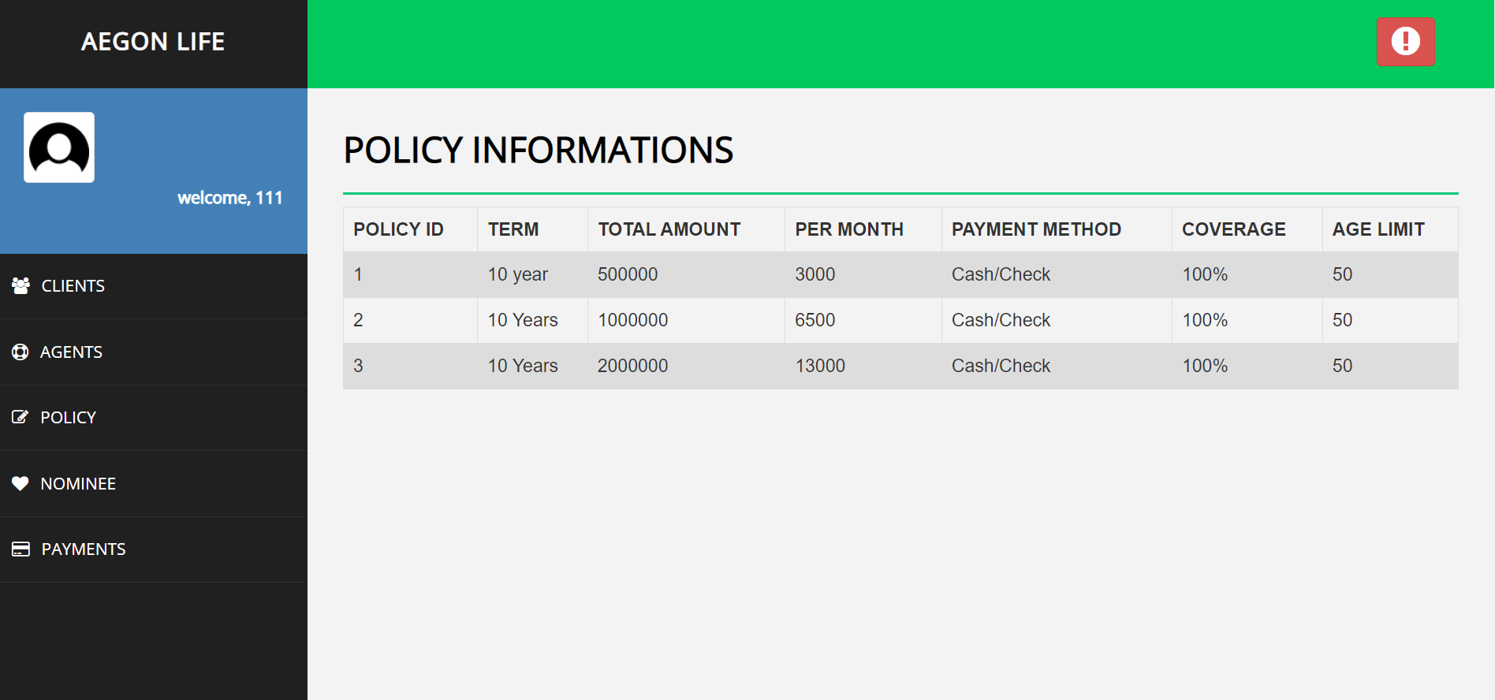
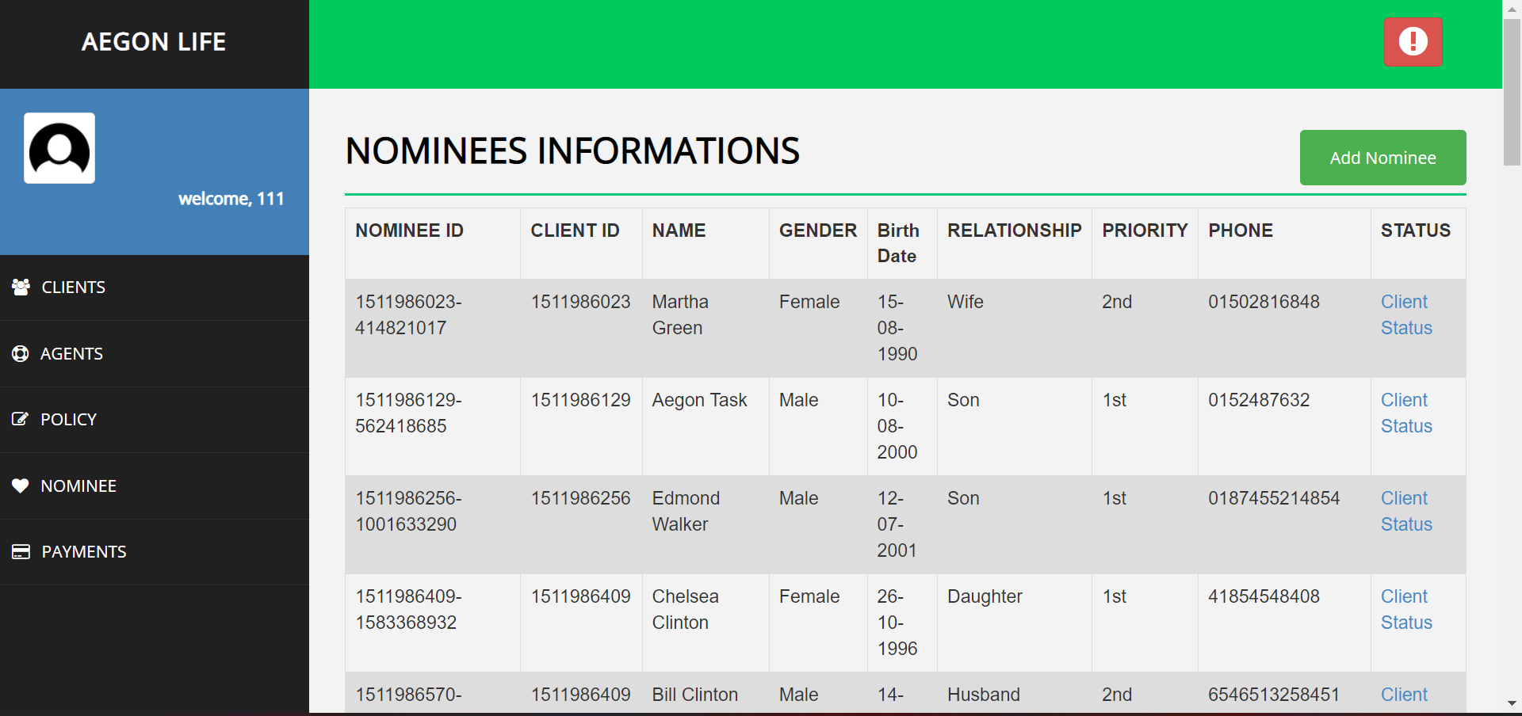

Slide 14
conclusion
I have navigate the life insurance management web application and find out the positive/pass and negative/fail test caese.This is to improve the application performance in better manner

